Slide 1

The Data Science Hierarchy of Needs
Updated 10.22.19

Slide 2

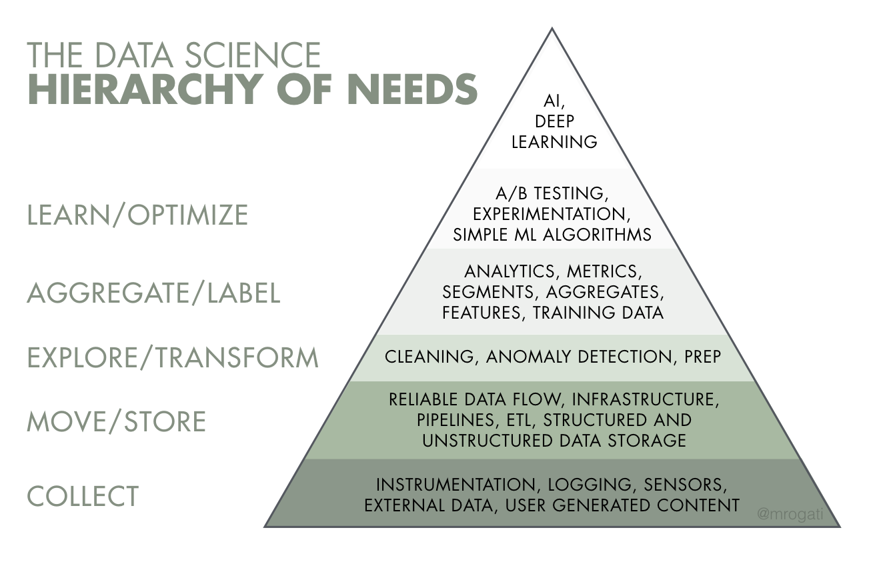

Slide 3
Data Science Lifecycle
Updated 10.22.19

Slide 5
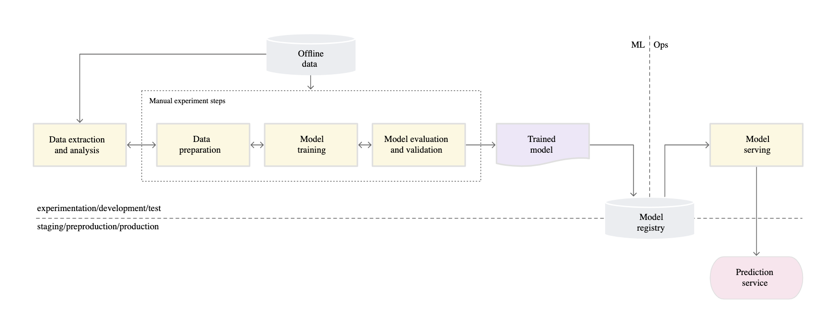

Slide 6
Data Science Roles and Tools
Updated 10.22.19

Slide 7
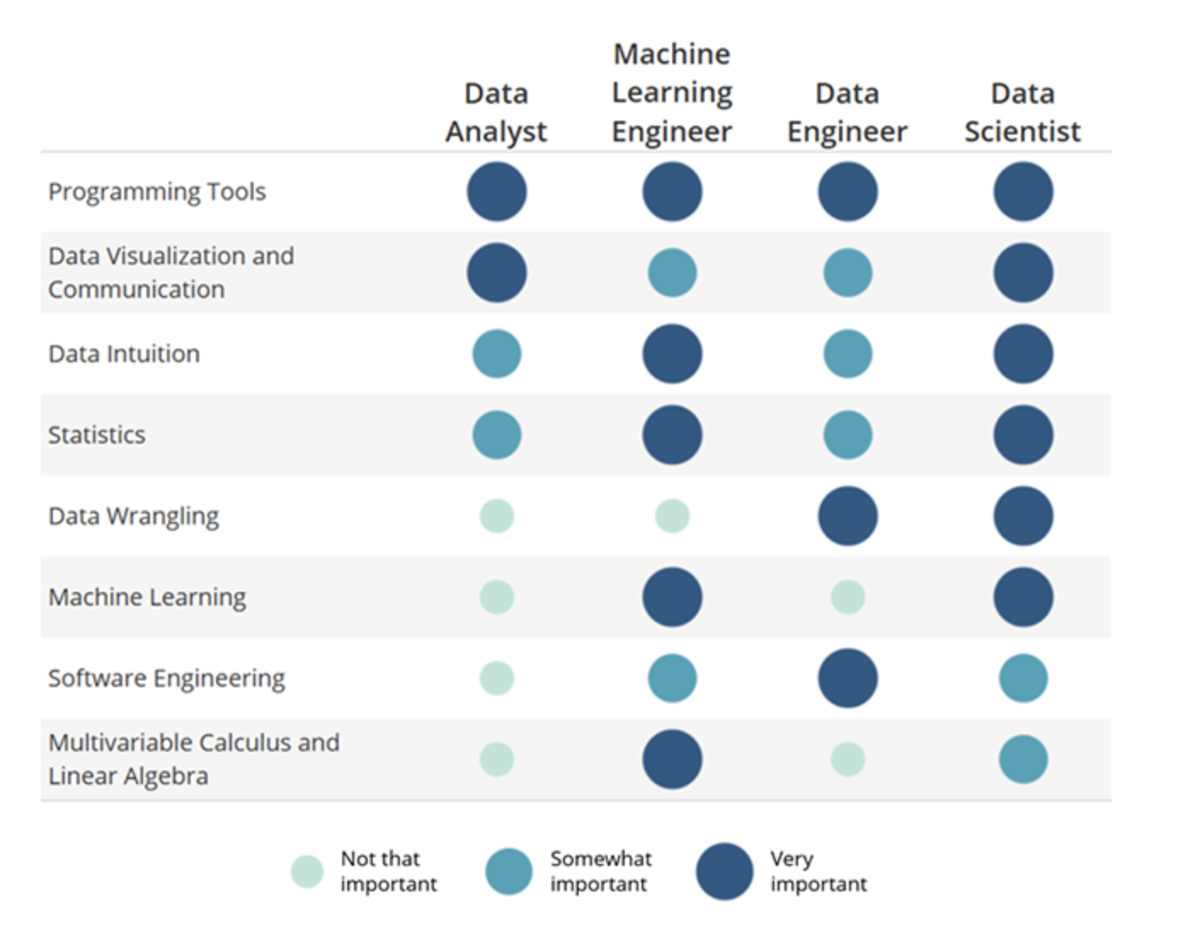

Slide 8
Data Science Tools and Roles Infographic

Slide 9
Machine Learning In Production
Updated 10.22.19

Slide 10
According to report, 2020 State of Enterprise Machine Learning, only 22 percent of companies that use machine learning have successfully deployed an ML model into production.

Slide 11
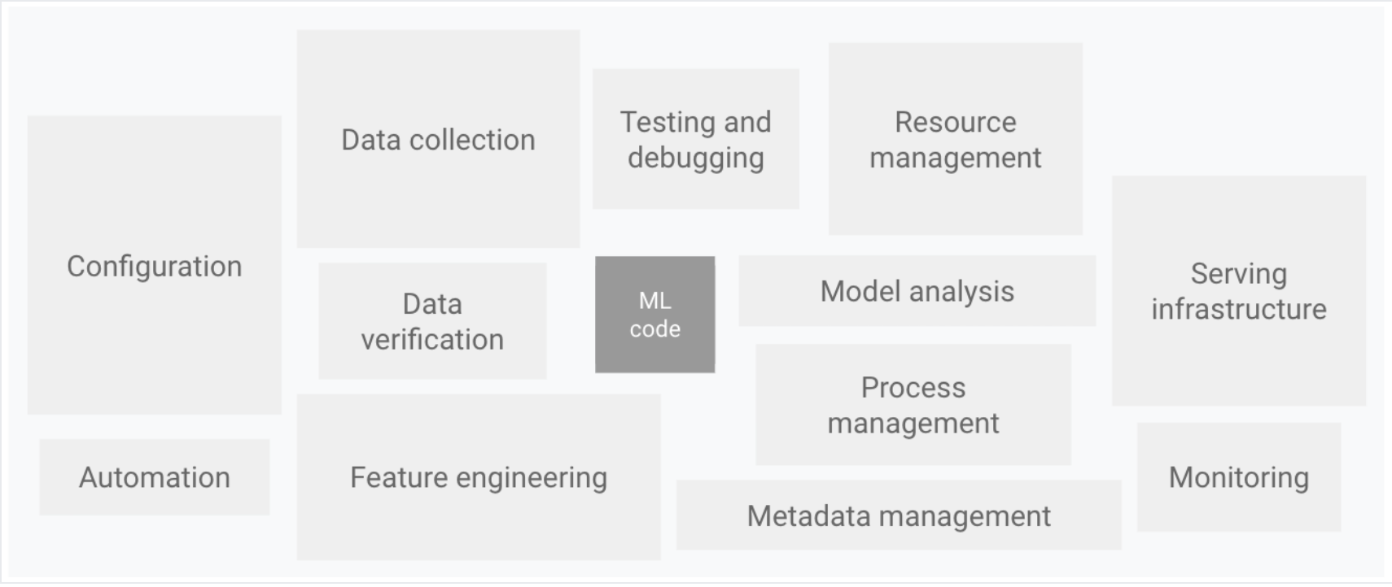

Slide 12
Business Considerations for Machine Learning
Updated 10.22.19

Slide 13
Performance
Time
Cost
Scenario 1: Model with 99% accuracy and inference time of ten seconds
Scenario 2: Model with 80% accuracy and inference time of one second

Slide 14
Business Impact of Evaluation Metrics
Updated 10.22.19

Slide 15
Classification Metrics
Accuracy
Recall
Precision
Use Case 1: Should the tourist be quarantined?
Use Case 2: Is the employee going to resign?

Slide 16
Thank you!

